Slide 1
ARL Notice List Management
David Mueller
Cohen Ellis
Nathan Gaar

Slide 2
Conceptual Model

Slide 3
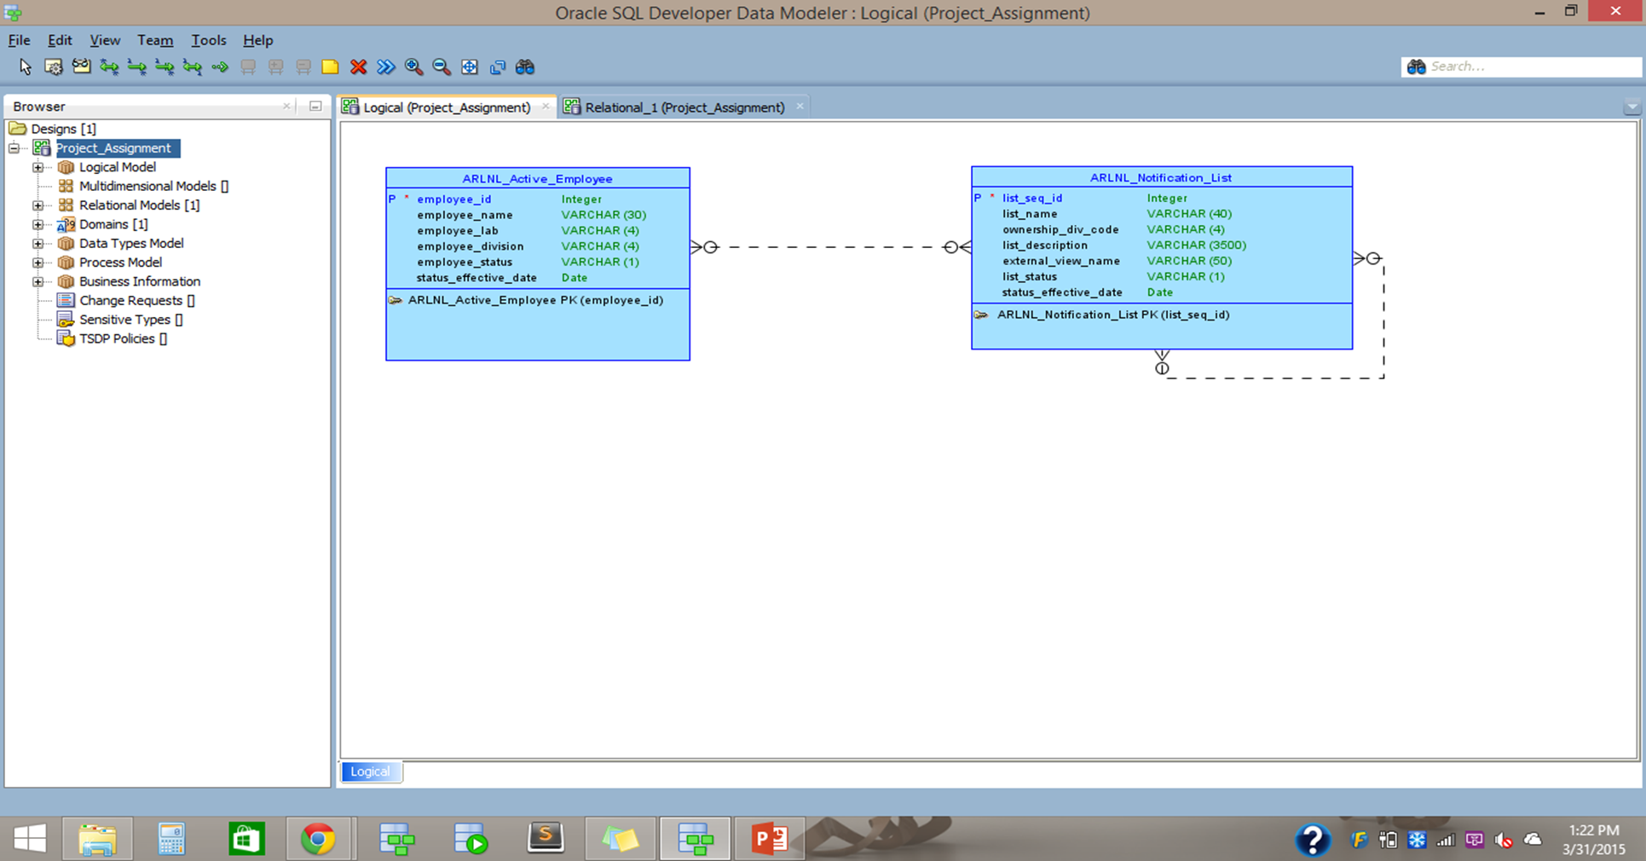

Slide 4
Logical Model

Slide 5
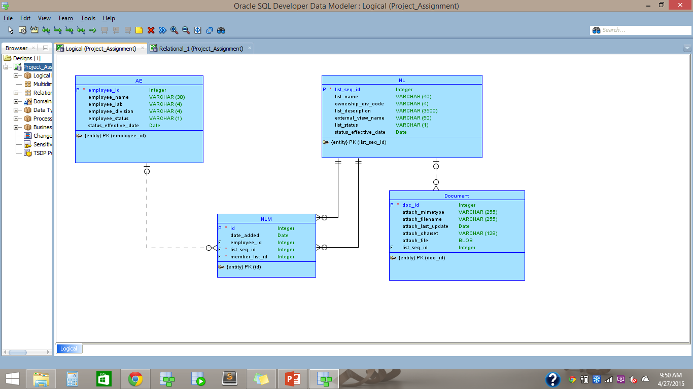

Slide 6
Requirements Not Met
User List Status Change and Notification
Notification to Users when Notice List Status Changes
Ability to upload any type of documents into the database with the option of associating it with a particular Project.
The ability to prevent a user from creating a cycle of lists

Slide 7
Satisfied Requirements

Slide 8
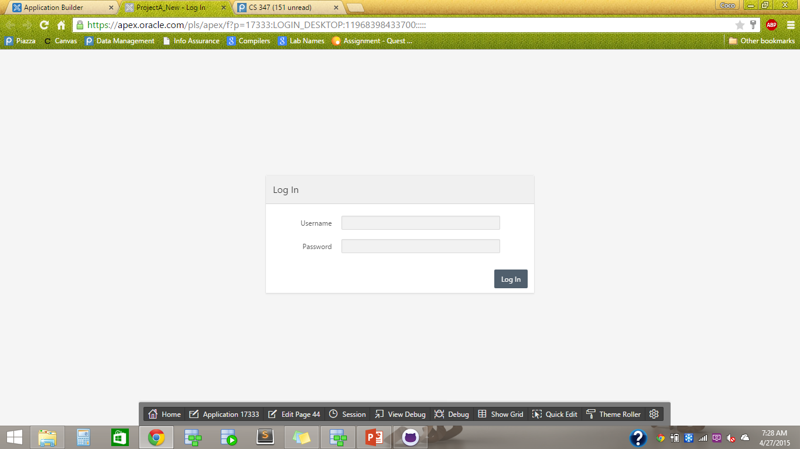

Slide 9
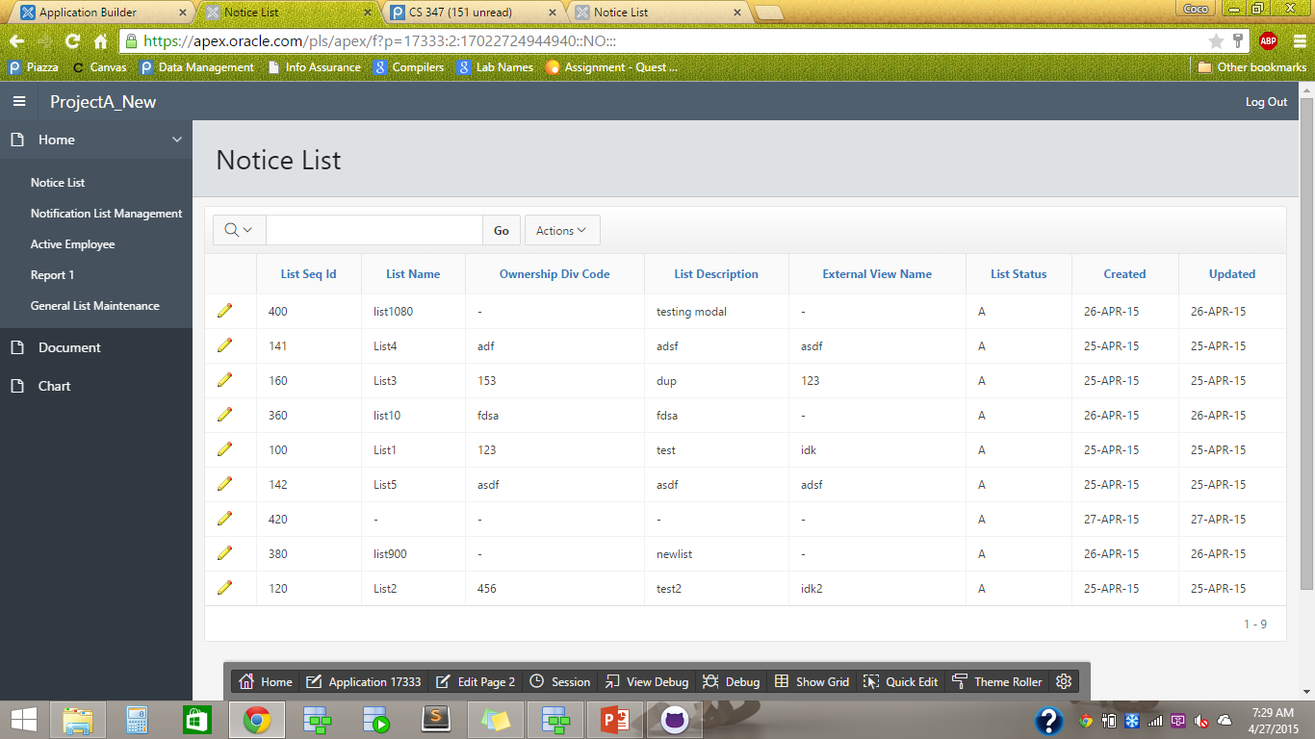

Slide 10
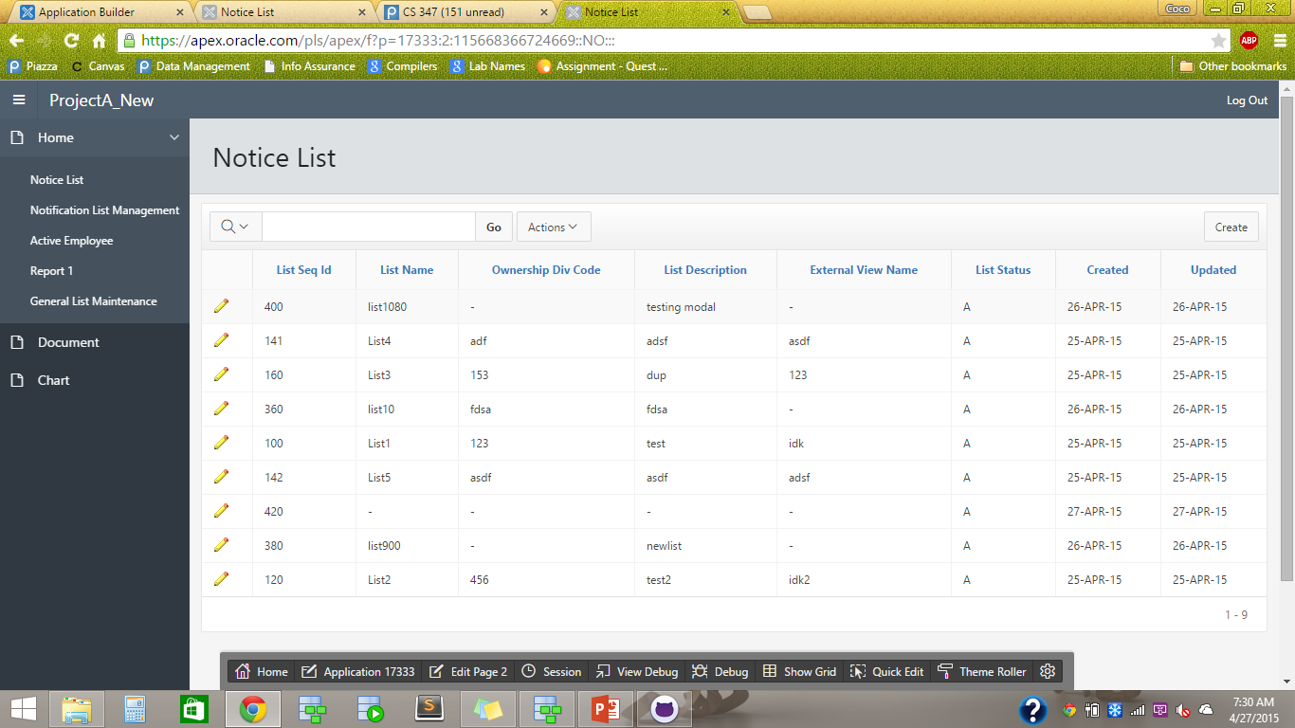

Slide 11
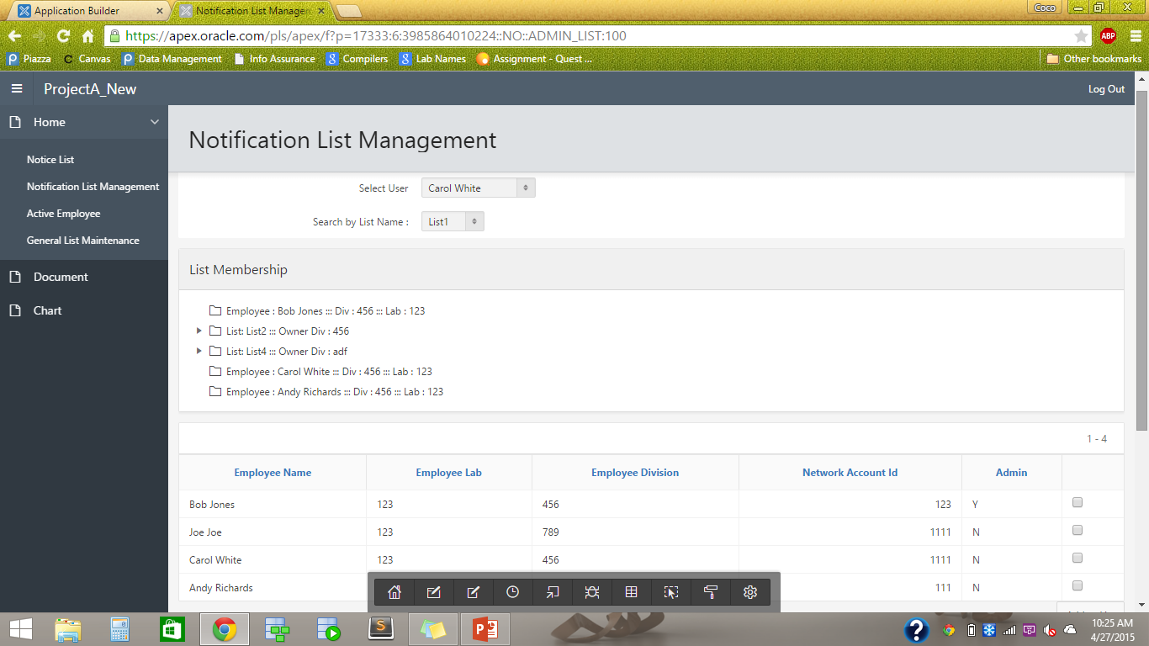

Slide 12
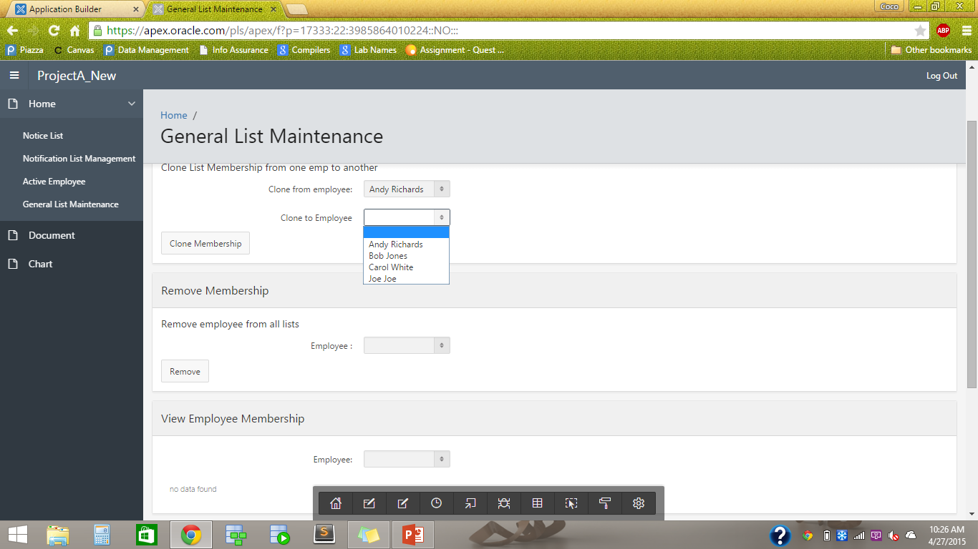

Slide 13
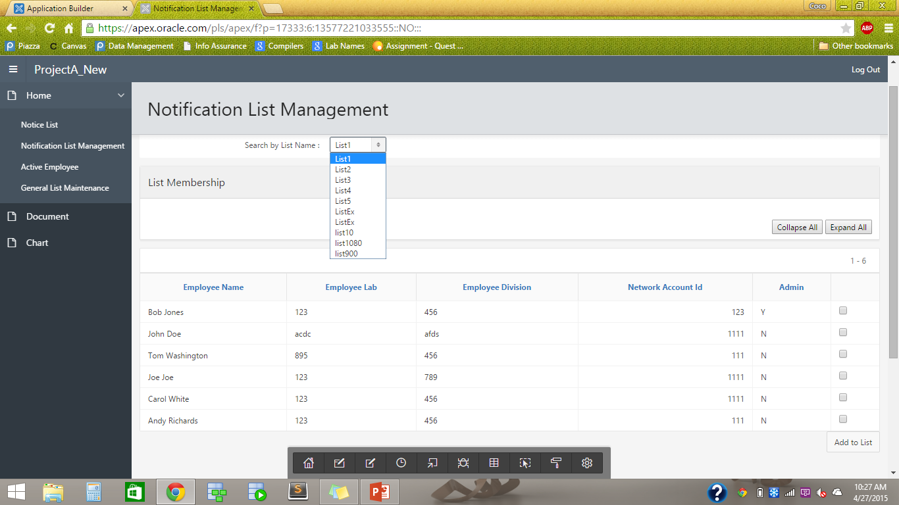

Slide 14
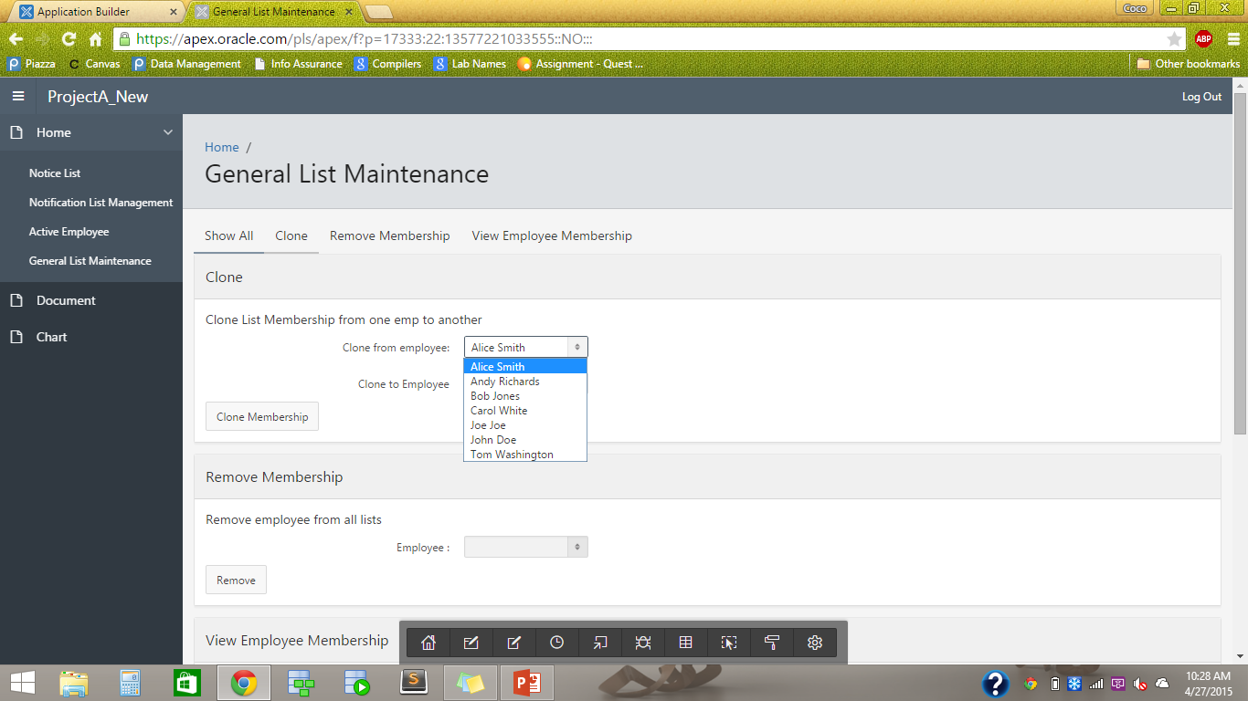

Slide 15
Good To Haves
Notification List Form Timer
Theme Roller

Slide 16
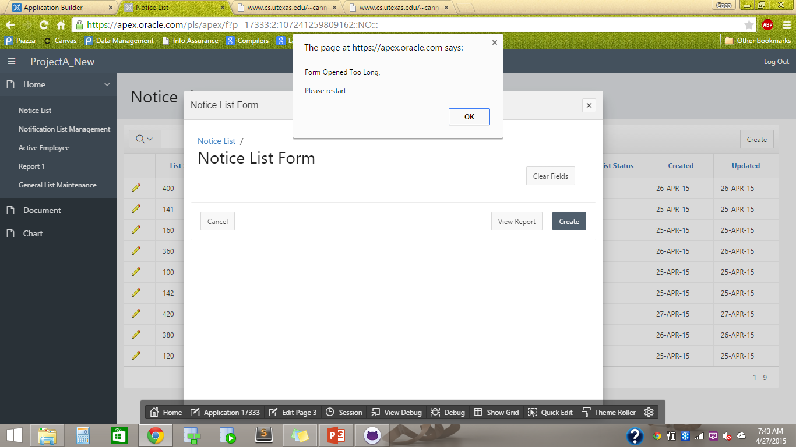

Slide 17
Link to Application
https://apex.oracle.com/pls/apex/f?p=17333:LOGIN_DESKTOP:11968398433700:::::
TO ACCESS USER PRIVILEGES
Username: user
Password: project
TO ACCESS ADMIN PRIVILEGES
Username: admin
Password: same as user

